Slide 1




Prompt Muon Forward Fit Pascal Gutjahr, Leander Flottau
wiki page
CR Call
November 18, 2025
Source: NASA

Slide 2


Introduction
Motivation
Characterize muon flux components and depth intensity
Probe hadronic interactions in the atmosphere
Constrain uncertainties and longstanding questions like the “muon puzzle”
Long term
Enhance understanding of hadronic processes relevant in distant astrophysical sources (e.g., supernovae, AGNs, …)
$φ_{tot}=φ_{prompt}+$ $φ_{conventional}$
Conventional Muon:
Parent is pion or kaon
Credit: Ludwig Neste

Slide 3
Overview
Simulation
Reconstruction
Selection
Unfolding
Dataset
CORSIKA 77500 Ehist
SIBYLL 2.3d
10 TeV – 100 EeV
Snowstorm
DNN reconstructions
Muon energies
Muon direction
Track geometry
Level 3
L2 muon filter
Add labels
Muon spectrum
Unfold muon flux at surface
Level 4
500 TeV bundle energy cut at surface
Add DNN reconstructions
Forward Folding
Validation
Tag prompt / conv particles
MCEq comparisons
Fit
Prompt normalization
Level 5
Data-MC quality cuts
Final Level
Leadingness cut

Slide 4
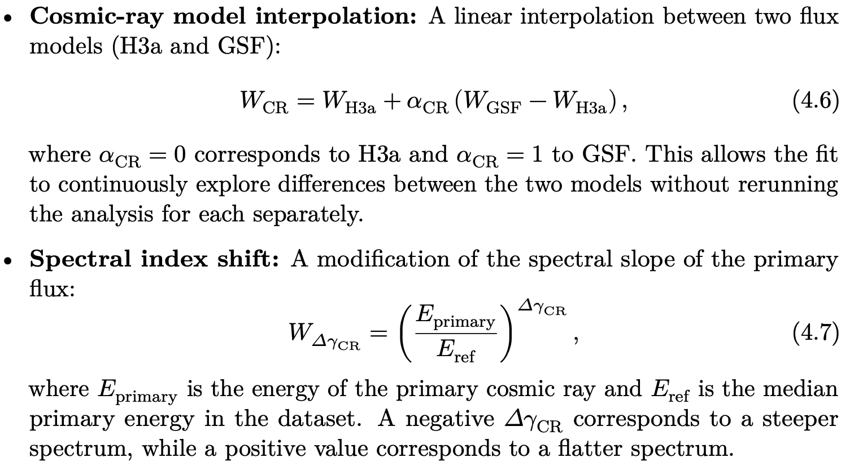
NNMFit
NNMFit
Actively maintained python tool → diffuse group uses it
Defines Likelihood (Poisson / SAY for limited MC statistics)
Incorporates nuisance parameters
5 in-ice detector systematics
CR-model interpolation
Spectral index shift
9 free fit parameter in total with
Conv norm
Prompt norm

Slide 5
Leading Energy Spectrum Final Level

Slide 6
12 years Prediction

Slide 7
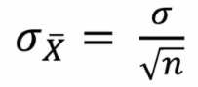
Binning
Bins
20 energy
2 zenith
Bias Plot
200 samples

Slide 8
Discovery Scan: Prompt Norm

Slide 9
2D Scans: Prompt Norm

Slide 10
Discovery Scan: Charmed & Unflavored

Slide 11
2D Scan: Charmed & Unflavored

Slide 12
Burnsample

Slide 13
Burnsample Normalization Fits
Bins
10 energy
2 zenith
Prompt
Charmed & Unflavored
Prompt norm = 0.87 ± 0.42

Slide 14
2D Scans Burnsample
Prompt
Charmed & Unflavored

Slide 15
Data—MC: Pre & Post Fit
Pre Fit
Post Fit

Slide 16
Summary
Use SAY likelihood in NNMFit to fit prompt (charm/unflavored) normalization
9 (10) free parameters
5 ice systematics
CR interpolation
Spectral index shift
Prompt (charm/unflavored) norm
12 years prediction for prompt norm > 7 sigma
Burnsample (~100 days) fit
Good data—mc agreement with fitted nuisance parameters
~1.7 sigma for prompt
Prompt norm = 0.87 ± 0.42

Slide 17
Backup

Slide 18
Reconstructions Level 4

Slide 19
Reconstructions Level 4

Slide 20
Poisson vs SAY
12 years lifetime
Final Level

Slide 21
LLH Scan Ice Systematics

Slide 22
LLH Scan CR Gradient & Spectral Index Shift

Slide 23
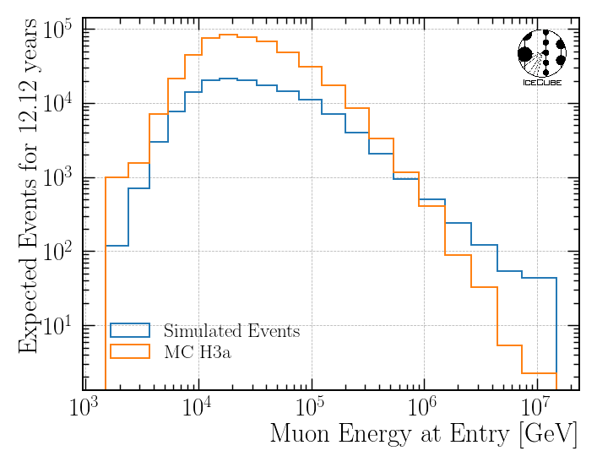
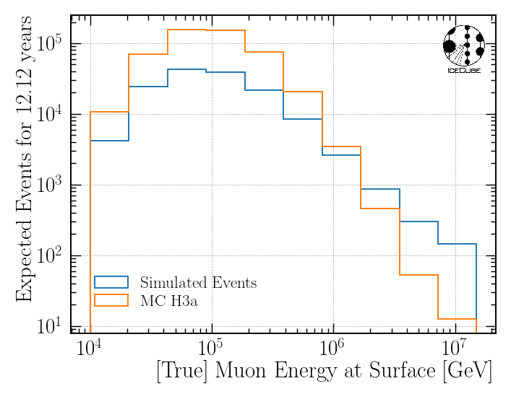
MC Statistics

Slide 24
Bias All Systematics
12 years lifetime
Final Level

Slide 25
Ice Systematics Impact on Bin 0
Baseline = entire snowstorm set

Slide 26
Test Different Binnings
12 years lifetime
Final Level

Slide 27
Parameter Correlations
Fit charmed & unflavored norm
Fit prompt norm

Slide 28
Fitted Systematics in Prompt Scan
Most nuisance parametes fitted within the boundaries
CR interpolation = 0 for prompt > 1.25

Slide 29
MC Statistics Final Level

Slide 30
Bundle Spectrum Final Level

Slide 31
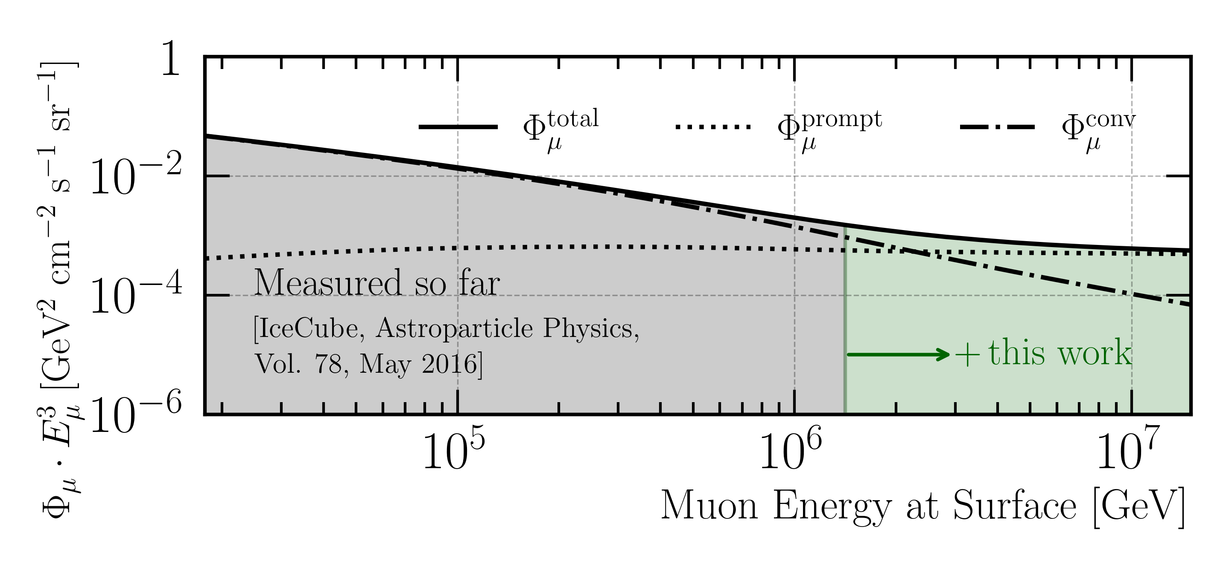
Goal: Measure Muon Flux at Surface
MCEq: SIBYLL 2.3d (H3a)

Slide 32
New CORSIKA simulation
with extended history option for information about the parent particles

Slide 33
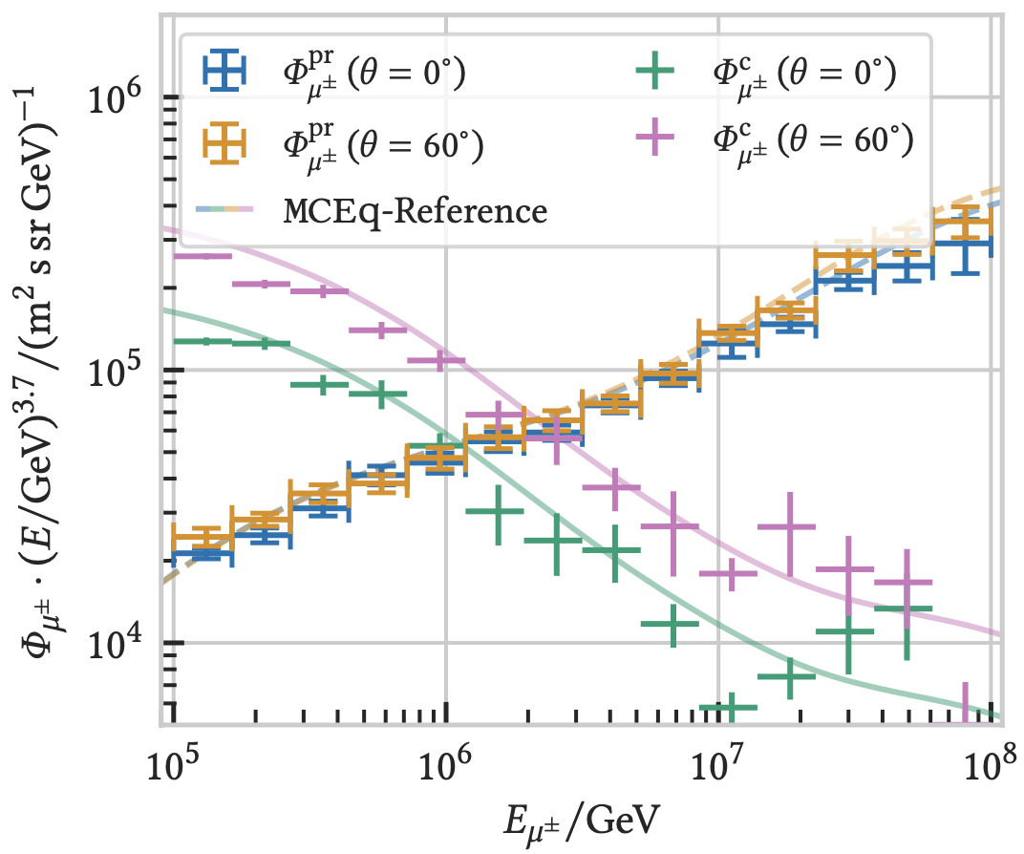

CORSIKA 7 vs. MCEq
MCEq: tool to numerically solve the cascade equations that describes the evolution of particle densities as they propagate through a gaseous, dense medium
https://github.com/mceq-project/MCEq
Good agreement for inclusive flux
Python package developed – PANAMA
Execute CORSIKA 7 (multi core)
Read DAT files → pandas DataFrames
Parse EHIST option
Calculate primary weightings
https://github.com/The-Ludwig/PANAMA
Neste & Gutjahr et al., EPJ C, 85, 759 (2025)

Slide 34
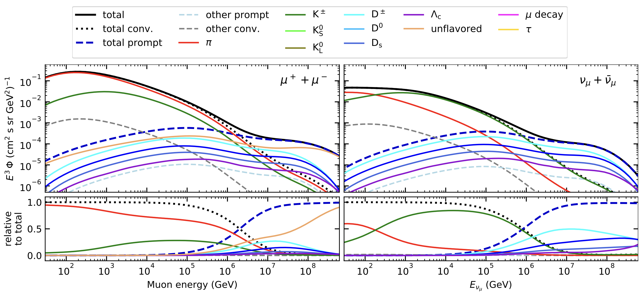
Prompt atmospheric muons and neutrinos
10.1103/PhysRevD.100.103018
no unflavored
dominated by pions
dominated by kaons
Combined fit:
handle on pion/kaon ratio
handle on charmed mesons

Slide 35
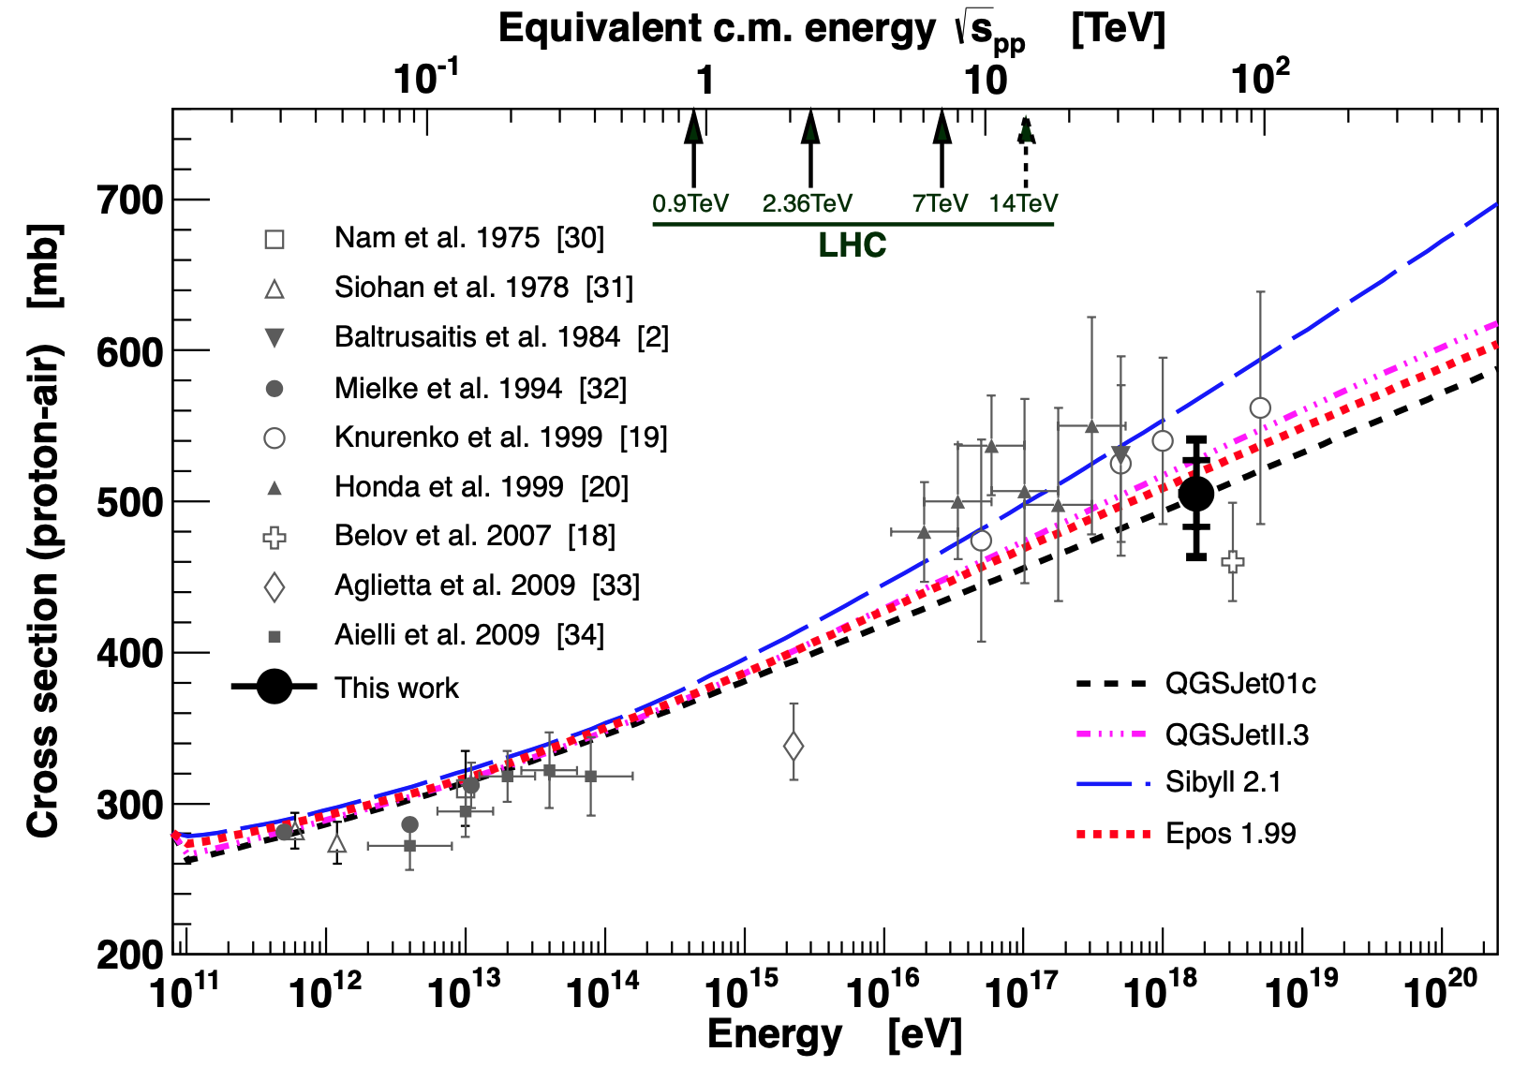
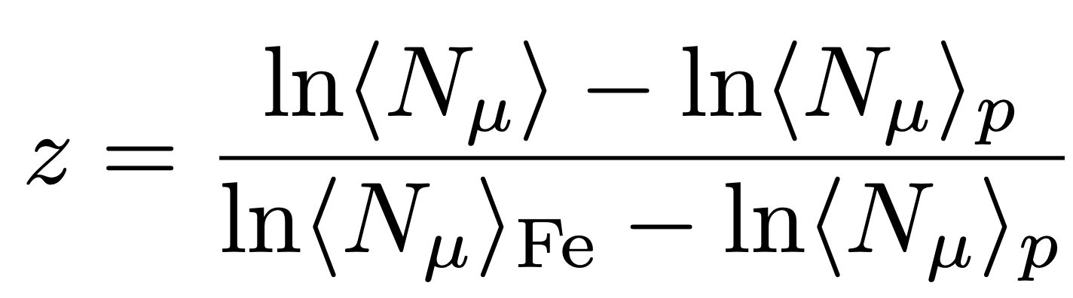
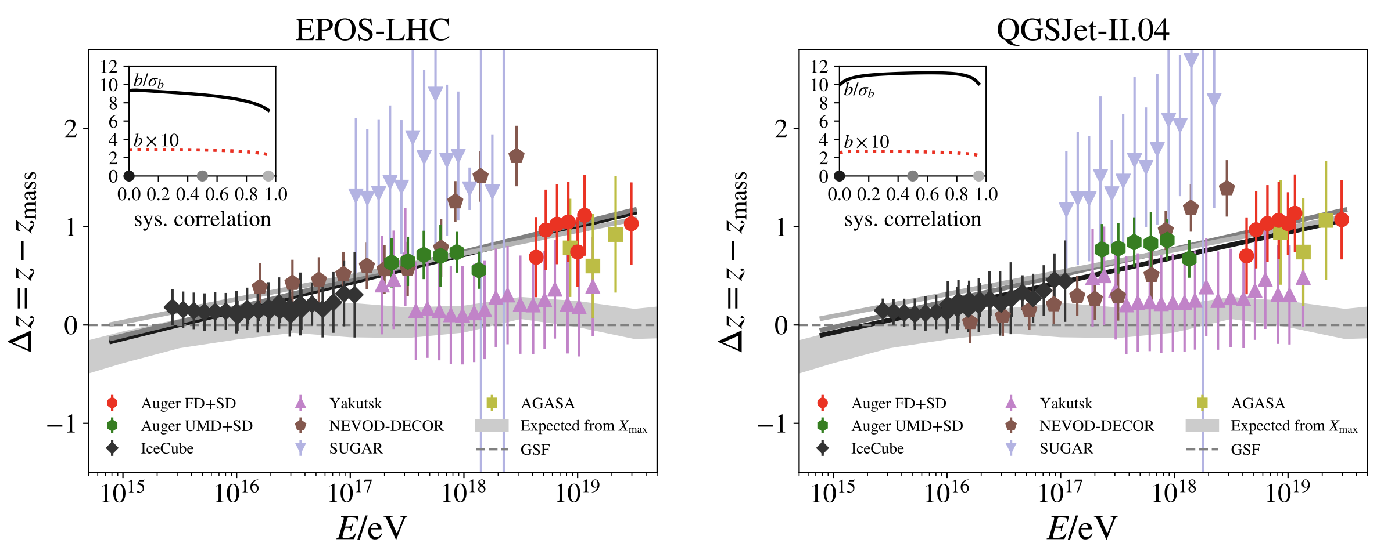
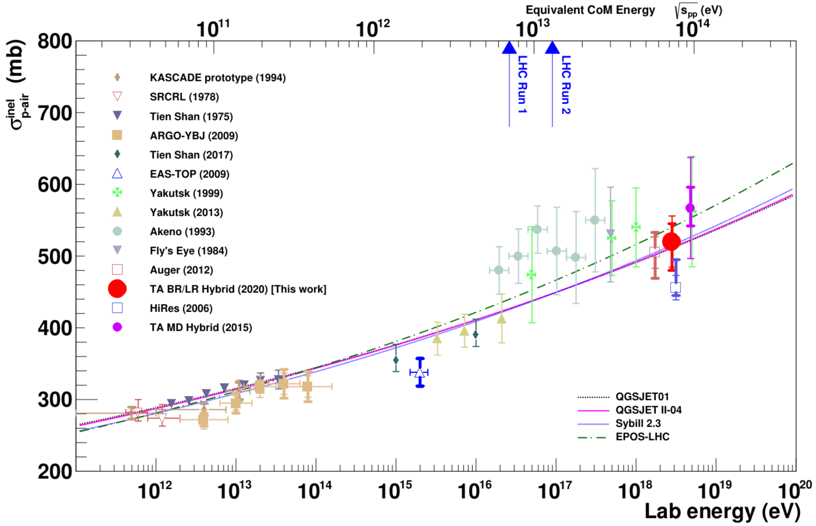
Muon puzzle and model uncertainties
”muon number”
Expected z
(“muon number”)
2012
2108.08341
1208.1520
Uncertainties at E > 10 PeV
2020
More muons measured than simulated for E > 40 PeV ~ cms 8 TeV
2006.05012

